Slide 1

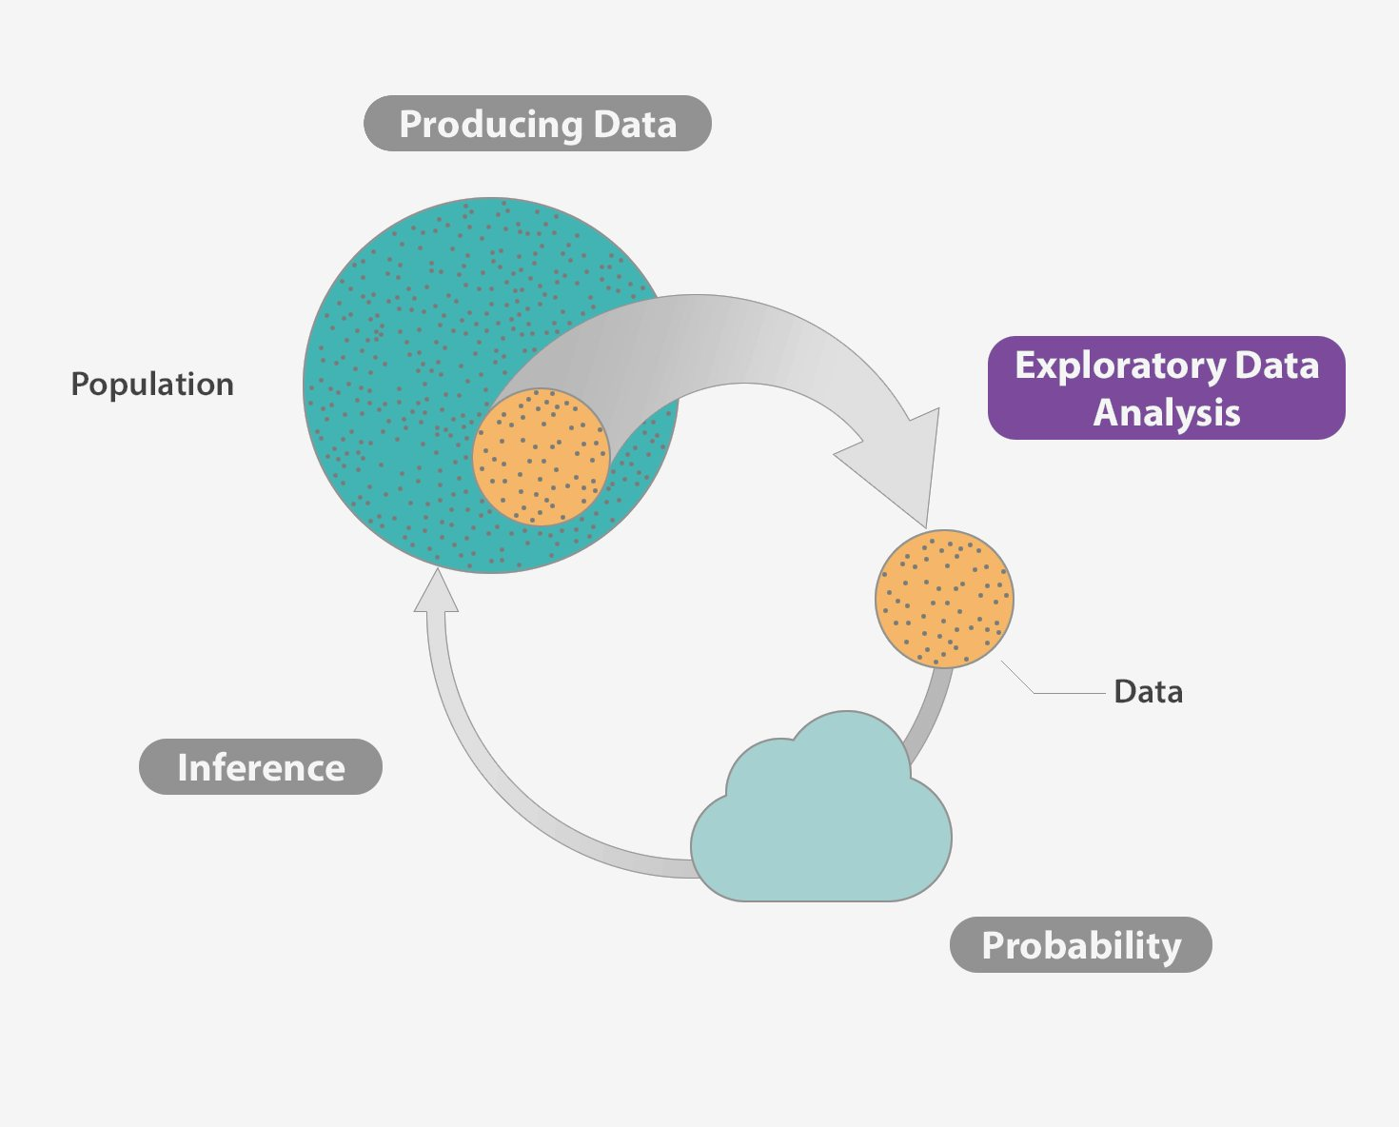

Student Accommodation With Preference Analysis and Geo-location Data
Alli Khadga Jyoth 19024
DSE

